Slide 1
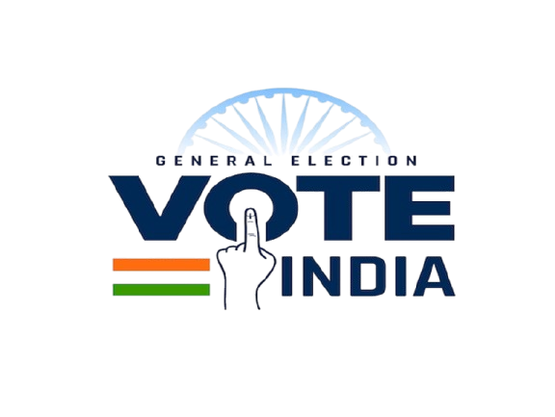
India Parliament Election 2024 Analysis
Prepared by
Nandavardhan Reddy Kopparthi

Slide 2
Objective & Scope
• This deck summarizes the 2024 Lok Sabha election outcomes using your uploaded data files.
• All insights are computed directly from raw CSVs to avoid misinterpretation from filtered report pages.
• We focus on national party performance, state highlights, and constituency victory margins.
• Where a slide references a state/constituency, it is explicitly scoped to that geography.

Slide 3
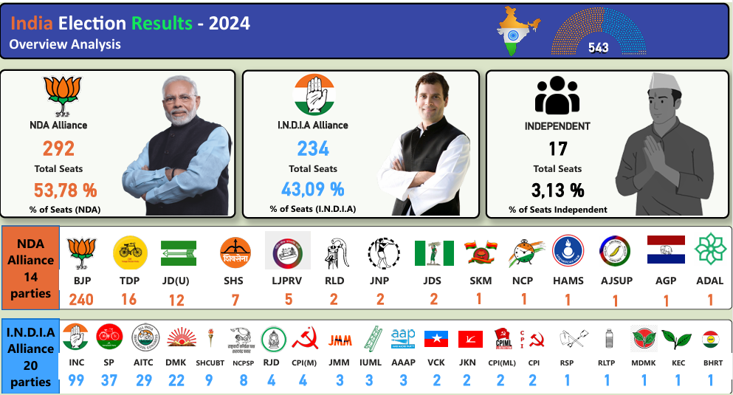
National Overview — Party Seats

Slide 4
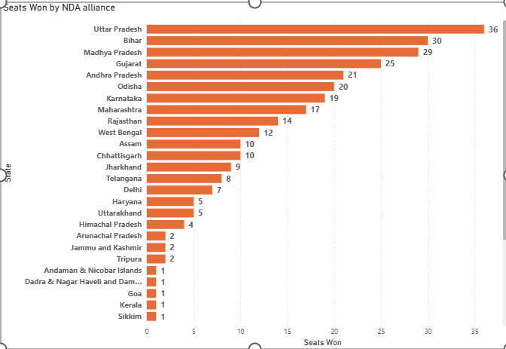
NDA Alliance State wise Analysis
Strongest Performers: Uttar Pradesh (36), Bihar (30), and Madhya Pradesh (29) lead NDA’s dominance across key northern states.
Consistent Presence: Gujarat, Andhra Pradesh, and Odisha each delivered 20+ seats, showing balanced national reach.
Limited Footprint in South & East: NDA holds minor representation in states like Kerala, Goa, and Sikkim, indicating regional opportunity gaps.

Slide 5
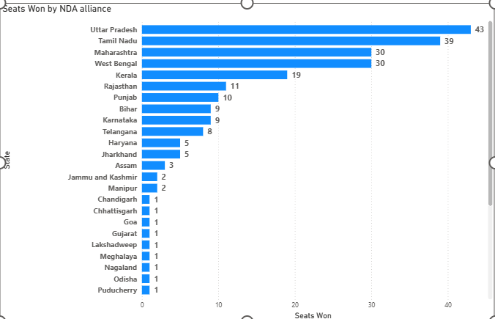
I.N.D.I.A Alliance State wise Analysis
Top Performers: Uttar Pradesh (43) and Tamil Nadu (39) lead the I.N.D.I.A alliance’s seat share, reflecting strong regional backing.
Expanding Influence: Maharashtra, West Bengal, and Kerala also show significant wins, strengthening the alliance’s footprint across diverse regions.
Regional Representation: Smaller but meaningful gains in Rajasthan, Punjab, and Telangana highlight the alliance’s broad electoral reach.

Slide 6
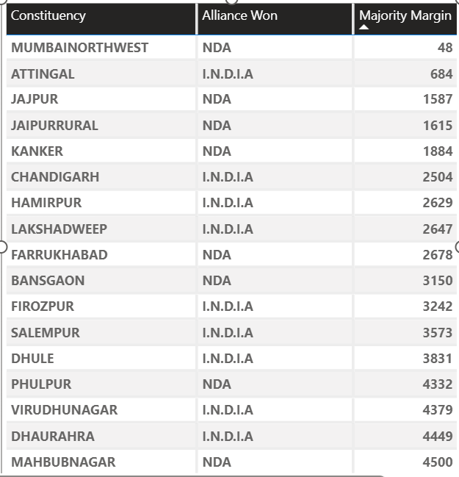
Closest Contests of Election 2024 – Margins Under 5,000 Votes
Nail-biting finishes: Mumbai North-West (NDA) recorded the narrowest margin of just 48 votes, the tightest race nationwide.
Balanced competition: Both NDA and I.N.D.I.A alliances feature across this list, showing high voter competition in multiple regions.
Regional spread: Close contests emerged across urban, coastal, and heartland constituencies — indicating diverse political swings.

Slide 7
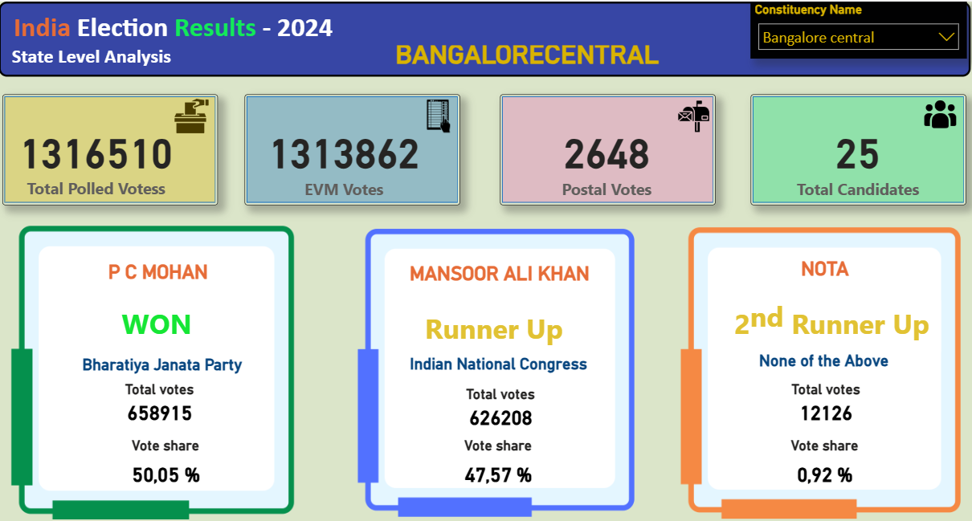
Spotlight Constituency Level – Bangalore Central
Key points:
Urban Two-Party Battle: BJP and INC dominated with over 97% of total votes, showing clear voter polarization.
BJP Stronghold Maintained: P. C. Mohan continued the party’s winning streak here since 2009.
Swing Potential: A margin of ~33K votes (2.5%) indicates this seat could easily flip in future elections

Slide 8
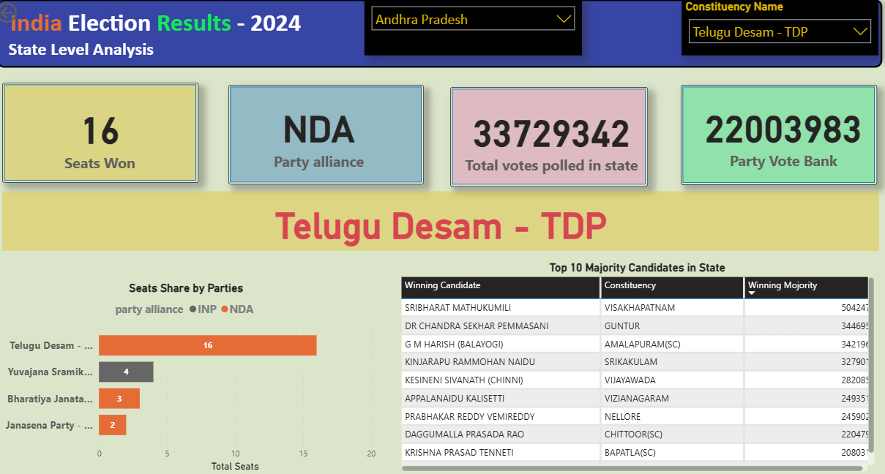
Spotlight Party in State level
Andhra Pradesh – TDP Leads NDA Surge
Key Points:
TDP Sweeps State: Won 16 of 25 seats, driving NDA’s comeback in Andhra Pradesh.
Strong Mandate: Garnered 2.2 crore votes — one of the highest regional vote shares.
Big Wins: Major seats like Visakhapatnam and Guntur saw 3L+ victory margins.

Slide 9
Key Takeaways
Bharatiya Janata Party - BJP leads nationally with 240 seats.
In Uttar Pradesh, Bharatiya Janata Party - BJP has the highest seat count (36).
Largest reported margin: 1175092 in INDORE by SHANKAR LALWANI.
Closest contest margin: 48 in MUMBAINORTHWEST by RAVINDRA DATTARAM WAIKAR.

Slide 10
Thanks for Reading
• Analysis powered by MySQL & Power BI
• Connect with me on LinkedIn:
linkedin.com/in/nandavardhan-reddy-kopparthi-3b420b370
Prepared by: Nandavardhan Reddy Kopparthi

